Slide 1
Angular Framework
Kinjal Lodha

Slide 2
Content
What is Angular?
Key Features of Angular
Advantages of Using Angular
Angular CLI: Streamlining Development
RxJS: Reactive Programming in Angular
Angular Material: UI Components for Angular
Angular Testing
Real-Time Business Case Scenarios: E-commerce Application
Reading Version in package.json

Slide 3
What is Angular?
01
02
03
Definition and Purpose
Core Technologies
Real-Time Business Applications
Angular is a platform and framework for building single-page client applications using HTML and TypeScript, designed to facilitate the development of dynamic web applications with a focus on performance and maintainability.
Angular leverages several core technologies, including TypeScript for type safety, RxJS for reactive programming, and Angular CLI for efficient project management, enabling developers to create robust applications with ease.
Angular is widely used in real-time business scenarios such as e-commerce platforms and data dashboards, where its capabilities in handling asynchronous data streams and dynamic content updates significantly enhance user experience and operational efficiency.

Slide 4
Key Features of Angular
Component-Based Architecture
Angular's component-based architecture promotes reusability and modularity, allowing developers to build encapsulated components that manage their own state and behavior, which is essential for maintaining large-scale applications efficiently.
Two-Way Data Binding
This feature enables automatic synchronization between the model and the view, reducing the need for manual DOM manipulation and enhancing productivity by ensuring that any changes in the data model are instantly reflected in the user interface, crucial for real-time applications.
Dependency Injection
Angular's built-in dependency injection system simplifies the management of service instances, promoting better organization of code and making it easier to test components in isolation, which is vital for developing scalable and maintainable business applications.

Slide 5
Advantages of Using Angular
01
02
03
Enhanced Performance
Robust Ecosystem
Strong Community Support
Angular's efficient change detection and ahead-of-time (AOT) compilation significantly improve application performance, allowing for faster rendering and a smoother user experience, especially in complex applications with dynamic content.
The extensive ecosystem of Angular, including a rich set of libraries, tools, and community support, provides developers with the resources needed to build scalable applications quickly and effectively, reducing development time and effort.
With a large and active community, Angular benefits from continuous updates, extensive documentation, and numerous third-party resources, ensuring that developers have access to the latest best practices and solutions for common challenges.

Slide 6
Angular CLI: Streamlining Development
Project Initialization and Setup
Angular CLI simplifies the process of creating a new Angular project by providing a command-line interface that automates the setup of project structure, configuration files, and dependencies, allowing developers to focus on coding rather than configuration.
Efficient Development Workflow
With features like live reloading and built-in development servers, Angular CLI enhances the development workflow by enabling real-time updates to the application as changes are made, significantly speeding up the testing and debugging process.
Automated Build and Deployment
Angular CLI streamlines the build process by offering commands for production builds that optimize performance through tree shaking and AOT compilation, ensuring that applications are ready for deployment with minimal manual intervention.

Slide 7
RxJS: Reactive Programming in Angular
01
02
03
Understanding RxJS
Role in Angular Applications
Real-Time Business Scenarios
RxJS (Reactive Extensions for JavaScript) is a library for composing asynchronous and event-based programs using observable sequences, enabling developers to manage data streams effectively and respond to changes in real-time within Angular applications.
In Angular, RxJS plays a crucial role by providing powerful tools for handling asynchronous operations, such as HTTP requests Additionally, interceptors provide a powerful mechanism for intercepting and modifying HTTP requests and responses, enhancing security and flexibility in your application’s interactions with external services.
Real-time business applications, such as live chat systems or stock market dashboards, leverage RxJS to handle continuous data streams, ensuring that users receive instant updates and notifications, thereby enhancing user engagement and operational efficiency.

Slide 8
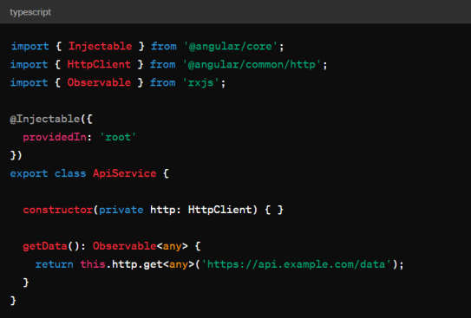
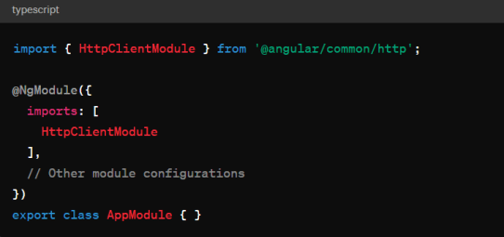
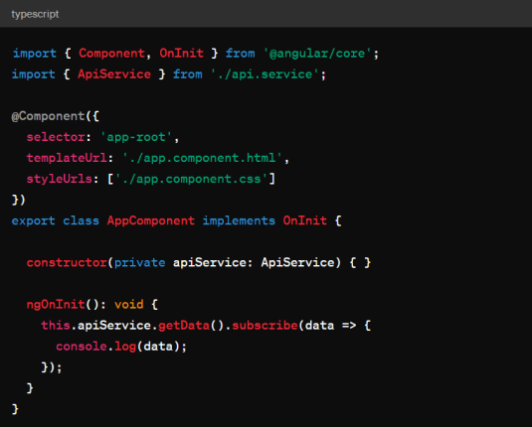
RxJS: Reactive Programming in Angular
Step 1:
Import HttpClientModule
Step 2:
Create a Service for API Calls
Step 3:
Subscribe to the Observable in Component

Slide 9
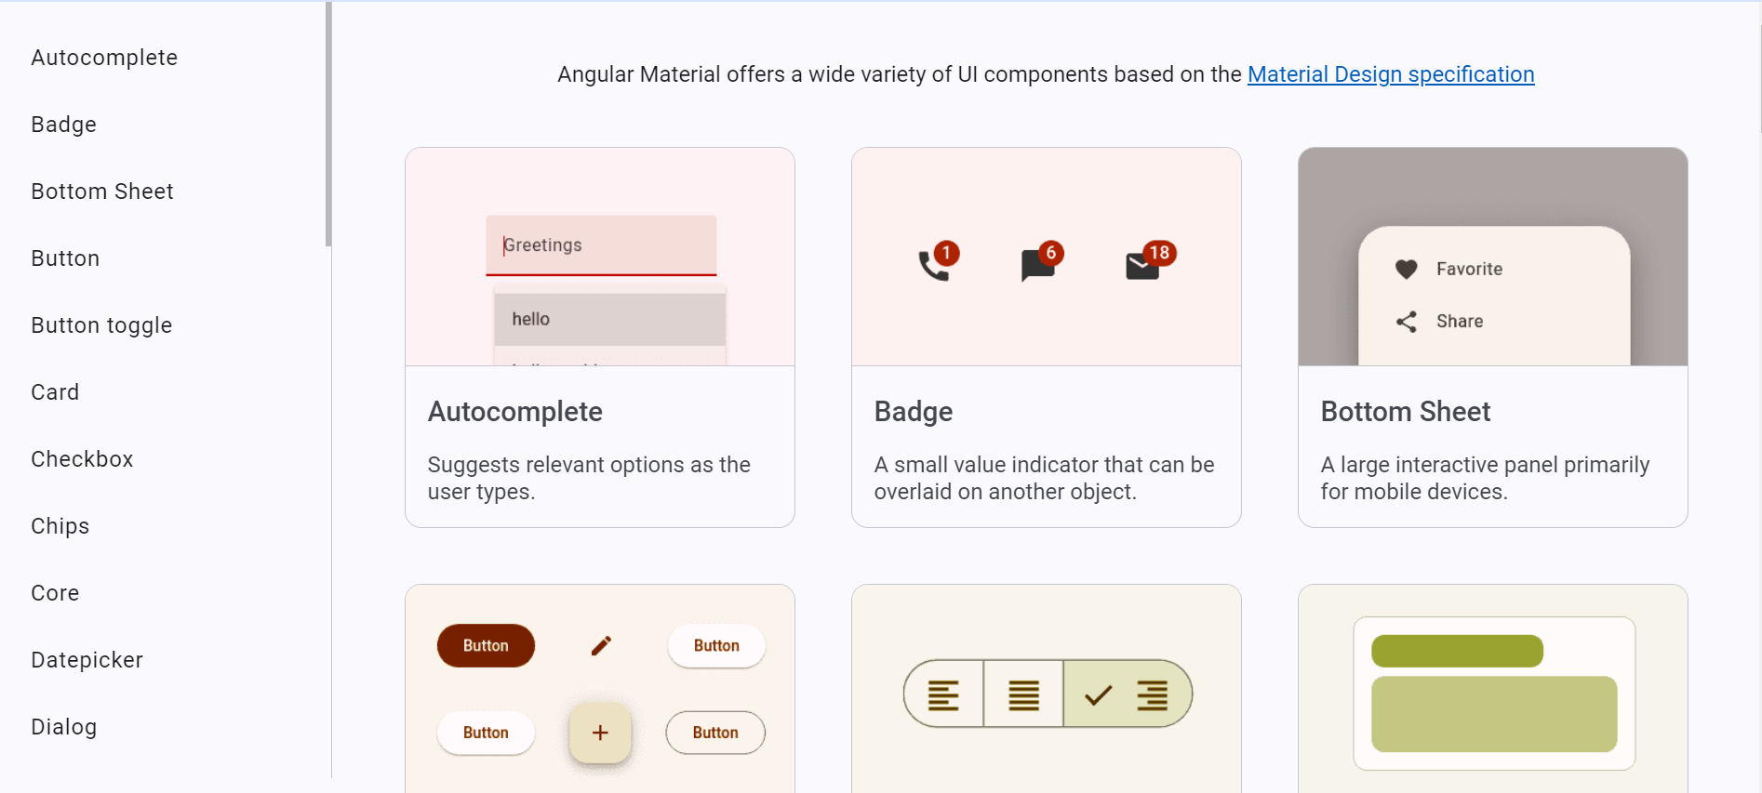
Angular Material: UI Components for Angular
Introduction to Angular Material
Angular Material is a UI component library that provides a set of reusable, well-designed components following the Material Design guidelines, enabling developers to create visually appealing and consistent user interfaces for Angular applications
Benefits of Using Angular Material
By utilizing Angular Material, developers can significantly reduce the time and effort required to build responsive layouts and interactive elements, as it offers pre-built components such as buttons, forms, and navigation menus that are optimized for performance and accessibility

Slide 10
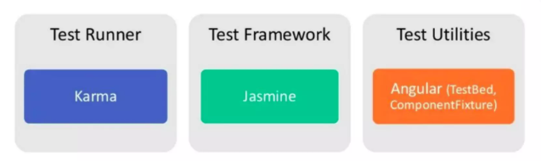

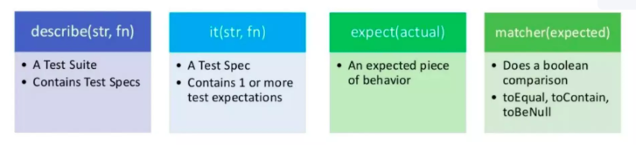
Angular Testing
Tools
Setup & Teardown
Jasmine Test Spec

Slide 11
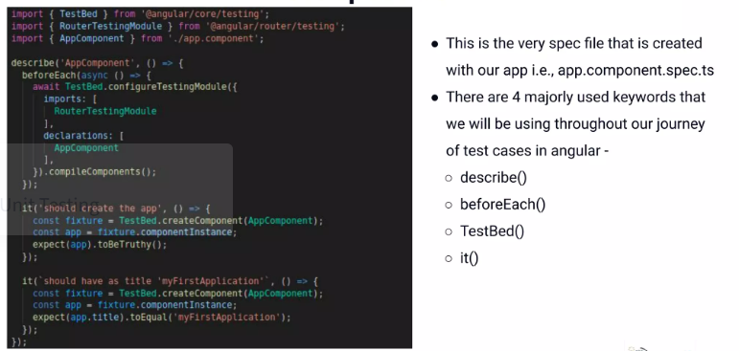
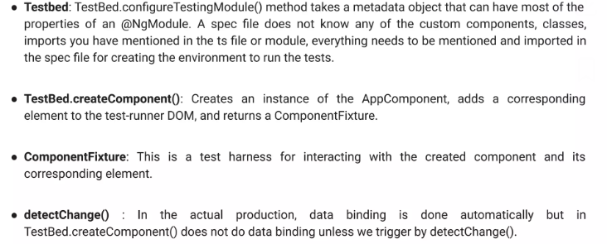
Angular Testing

Slide 12
Real-Time Business Case Scenarios: E-commerce Application
01
02
03
Real-Time Product Updates
Dynamic User Interfaces
Seamless Checkout Process
Angular's reactive programming capabilities allow for real-time updates of product availability and pricing, ensuring that users receive the most current information without needing to refresh the page, which enhances user engagement and satisfaction.
With Angular's component-based architecture, developers can create dynamic and responsive user interfaces that adapt to user interactions, such as personalized recommendations and shopping cart updates, leading to a more intuitive shopping experience.
By utilizing Angular's form handling and validation features, e-commerce applications can implement a streamlined checkout process that minimizes user errors and improves conversion rates, ultimately enhancing the overall user experience.

Slide 13
The Future of Angular: Trends and Predictions
01
02
03
Increased Adoption of Micro-Frontends
Enhanced Support
for Server-Side Rendering
Integration of AI and Machine Learning
As organizations seek to improve scalability and maintainability, the trend towards micro-frontends is expected to grow, allowing teams to develop and deploy independent Angular applications that can be integrated seamlessly, enhancing collaboration and reducing deployment times.
With the rising demand for improved performance, Angular is likely to enhance its support for server-side rendering (SSR) through frameworks like Angular Universal, enabling faster initial load times and better indexing by search engines, which is crucial for modern web applications.
The future of Angular may see increased integration with AI and machine learning technologies, allowing developers to build smarter applications that can provide personalized user experiences and automate complex tasks, thereby driving innovation in web development.

Slide 14
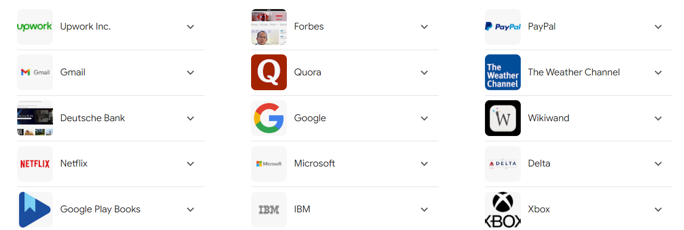
Top most used Angular applications across the world

Slide 15
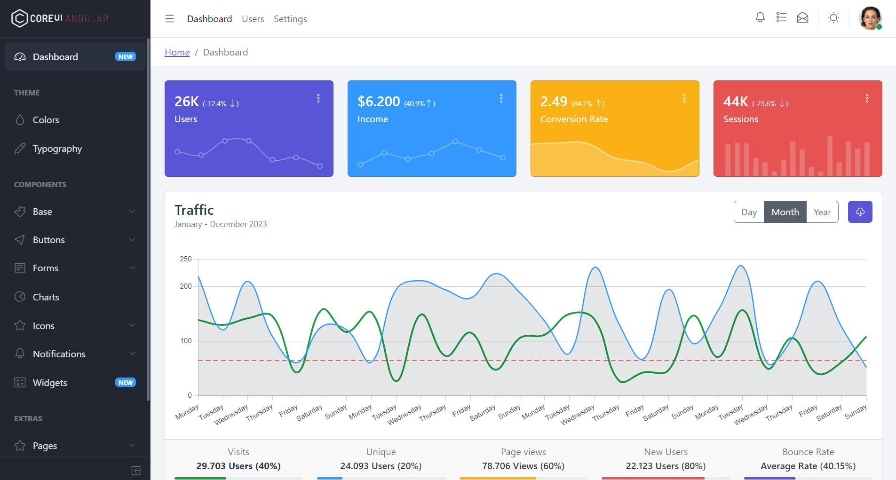
Angular Admin Template
https://coreui.io/demos/angular/5.0/free/#/dashboard

Slide 16
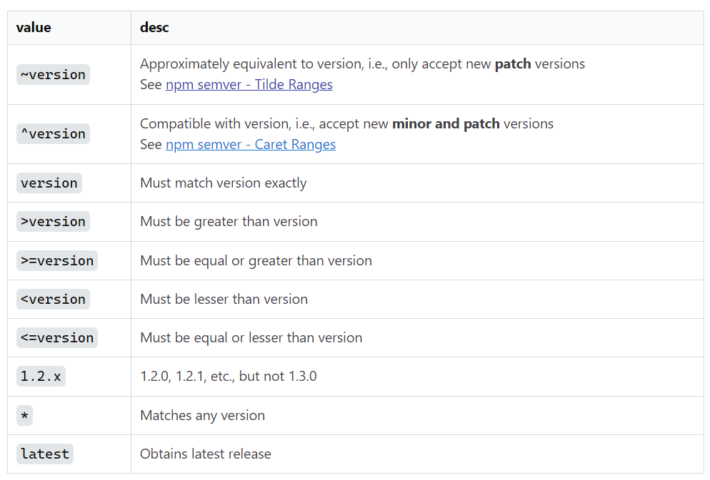
Angular Package.json Version reading
Notes:
~version “Approximately equivalent to version” without incrementing the minor version. ~1.2.3 will use releases from 1.2.3 to < 1.3.0.
^version “Compatible with version without incrementing the major version. ^1.2.3 will use releases from 1.2.3 to < 2.0.0.

Slide 17
Thank You

